Slide 1
PHOTOGRAPHY
Student Art / Virtual Exhibition
Arno Maris Gallery
December 2020
Instructor
Paul Bloomfield

Slide 2
Welcome to Digital Photography
You are invited to witness some very inventive works of art created by students in the WSU Art Department’s Photography class guided by their instructor Paul Bloomfield. With the advances made possible by taking photos digitally or using digital photos and in many cases manipulating and layering other images, one is introduced to a new world. As you view these creations you will notice that the ordinary is changed to the extraordinary. You will see common objects however they are changed by superimposing and juxtaposing imagery in unique ways. You will see a different view guided by the artists inventiveness. Enjoy this virtual exhibition. Imagine yourself separated from the common into the uncommon world through each students vision.
Faith Lund
Arno Maris Gallery Director
Westfield State University

Slide 3
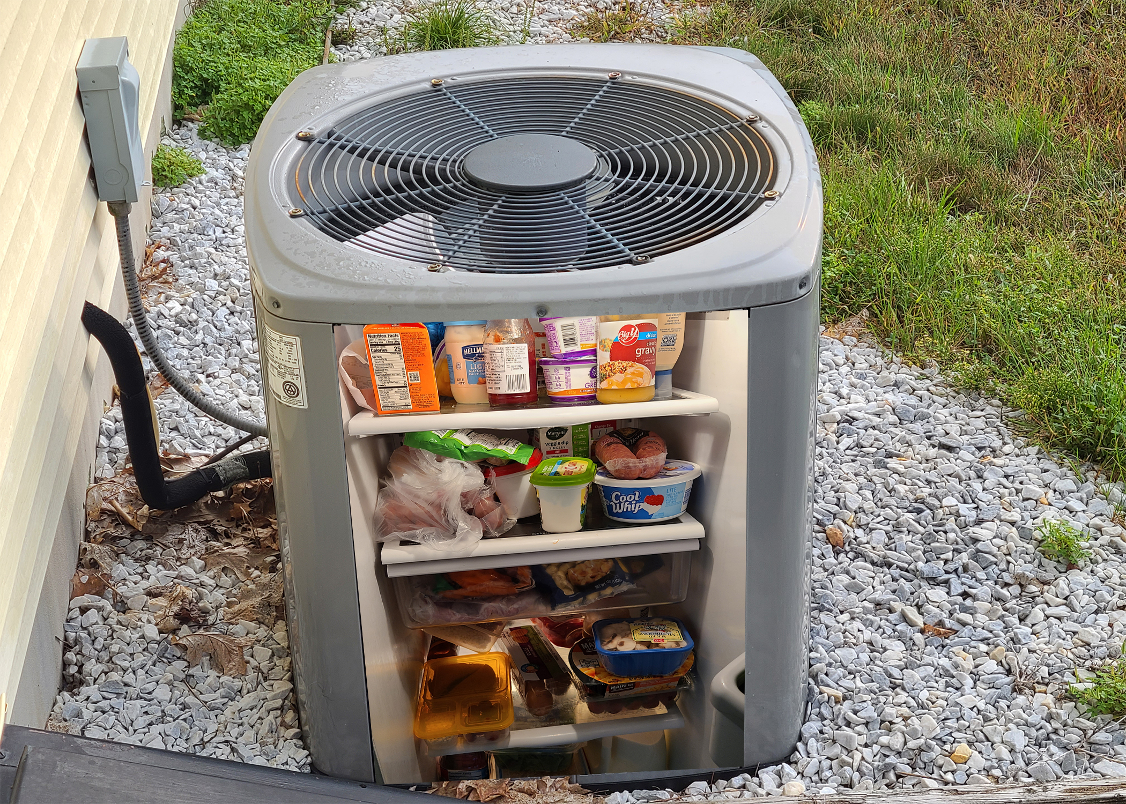
William Wozniakowski
ACF 2020
Digital Photograph/Digitally Manipulated Photograph

Slide 4
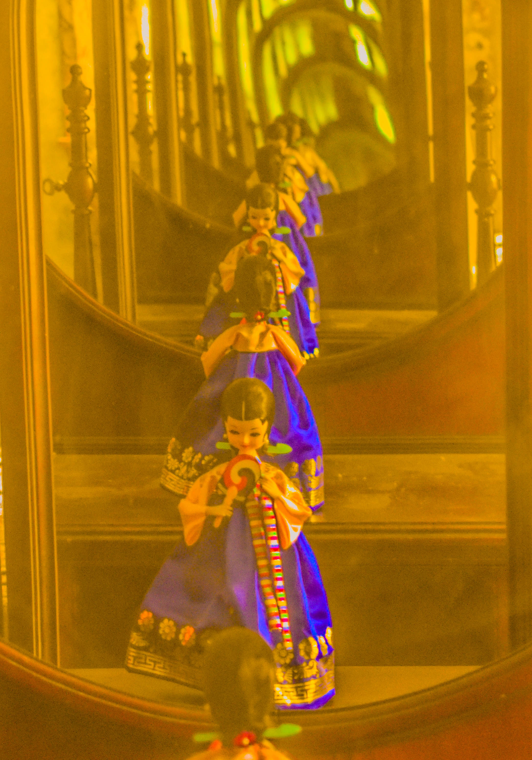
William Wozniakowski
Time Fly 2020
Digital Photograph/ Digitally Manipulated Photograph

Slide 5
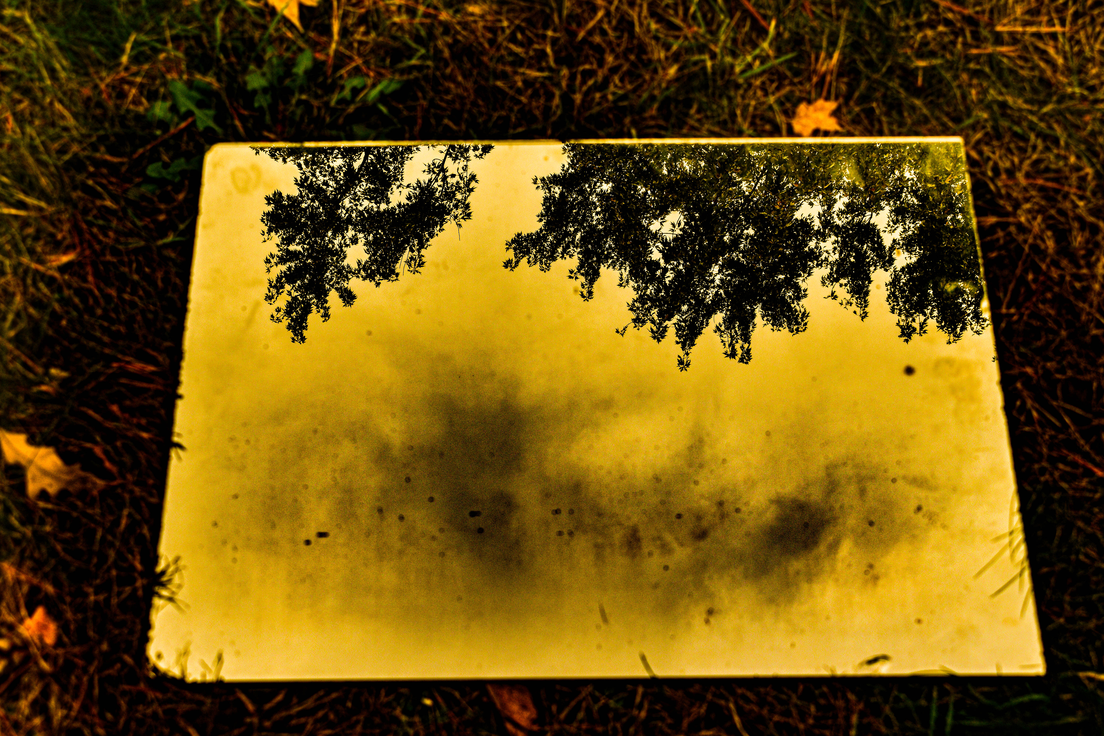
William Wozniakowski
Nights
Digital Photograph/Digitally Manipulated Photograph

Slide 6
William Wozniakowski
Shadow Mic
Digital Photograph/Digitally Manipulated Photograph

Slide 7
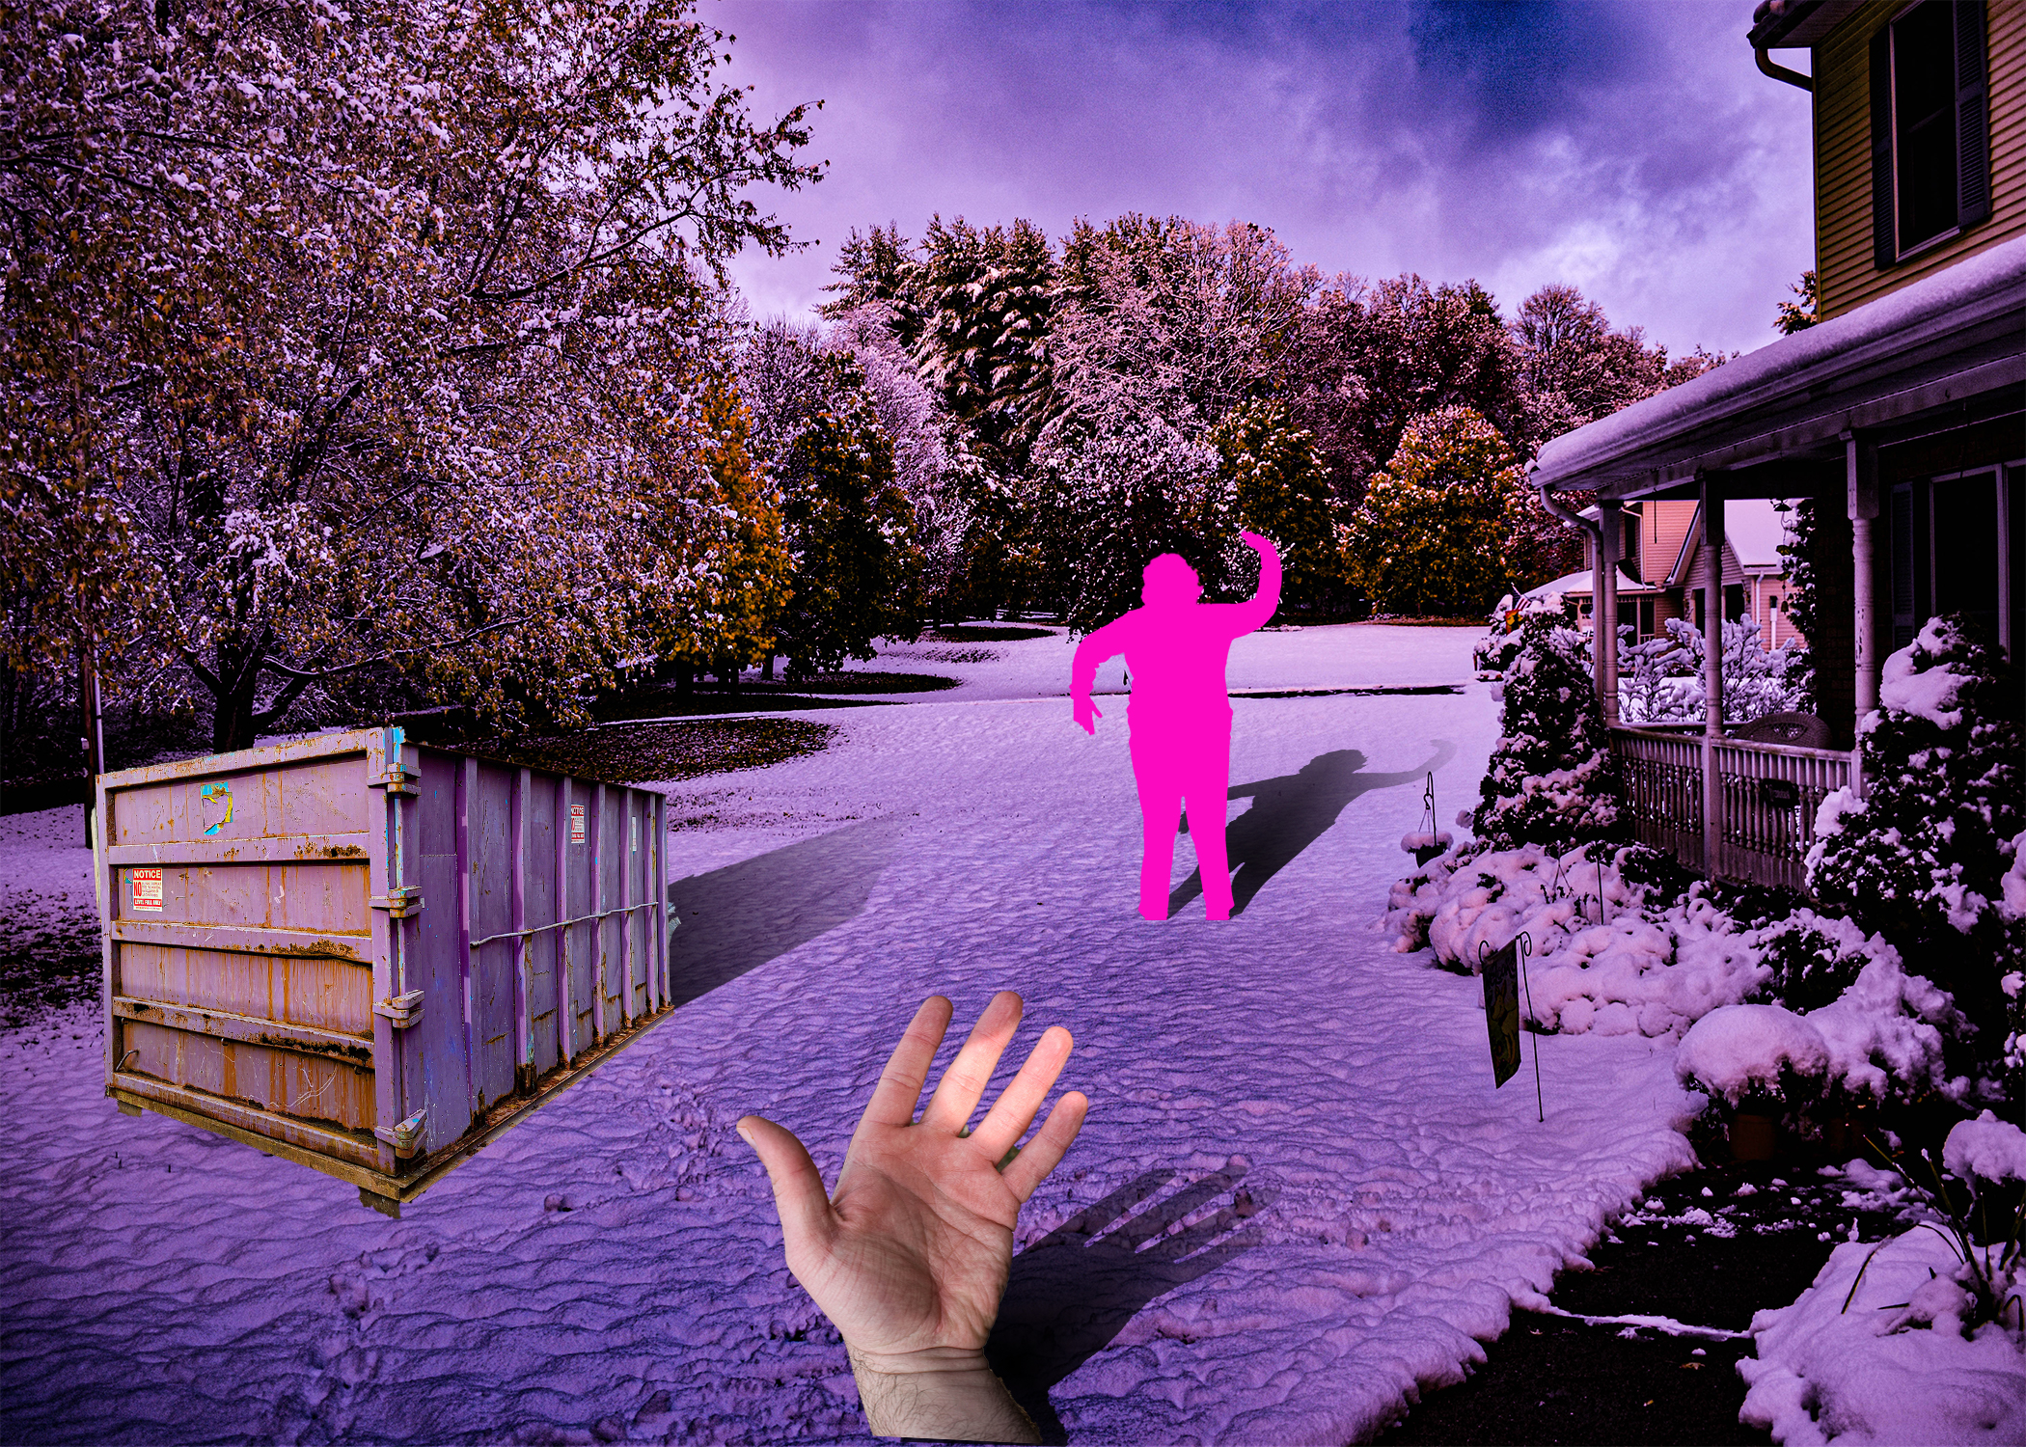
William Wozniakowski
Snow Two 2020
Digital Photograph/Digitally Manipulated Photograph

Slide 8
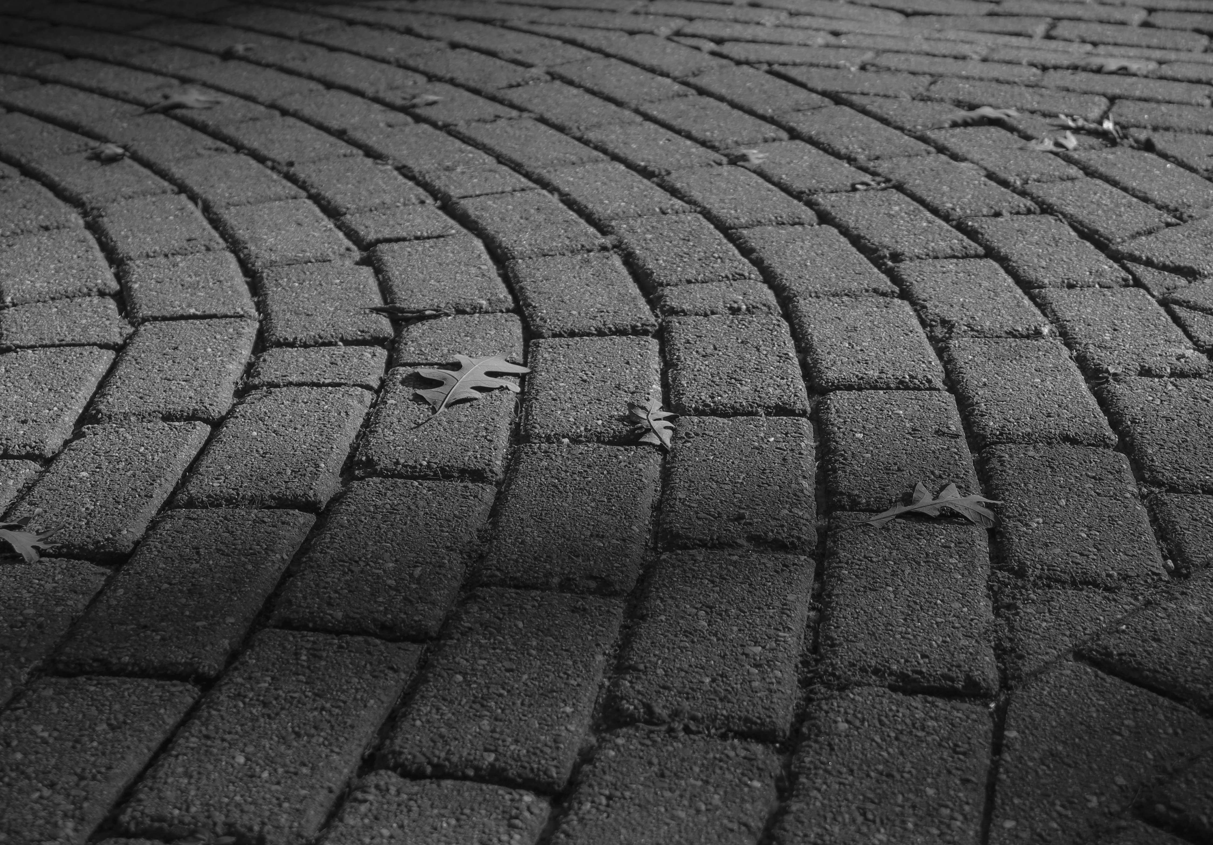
Allison Webster
W Pathway
Digital Photograph/Digitally Manipulated Photograph

Slide 9
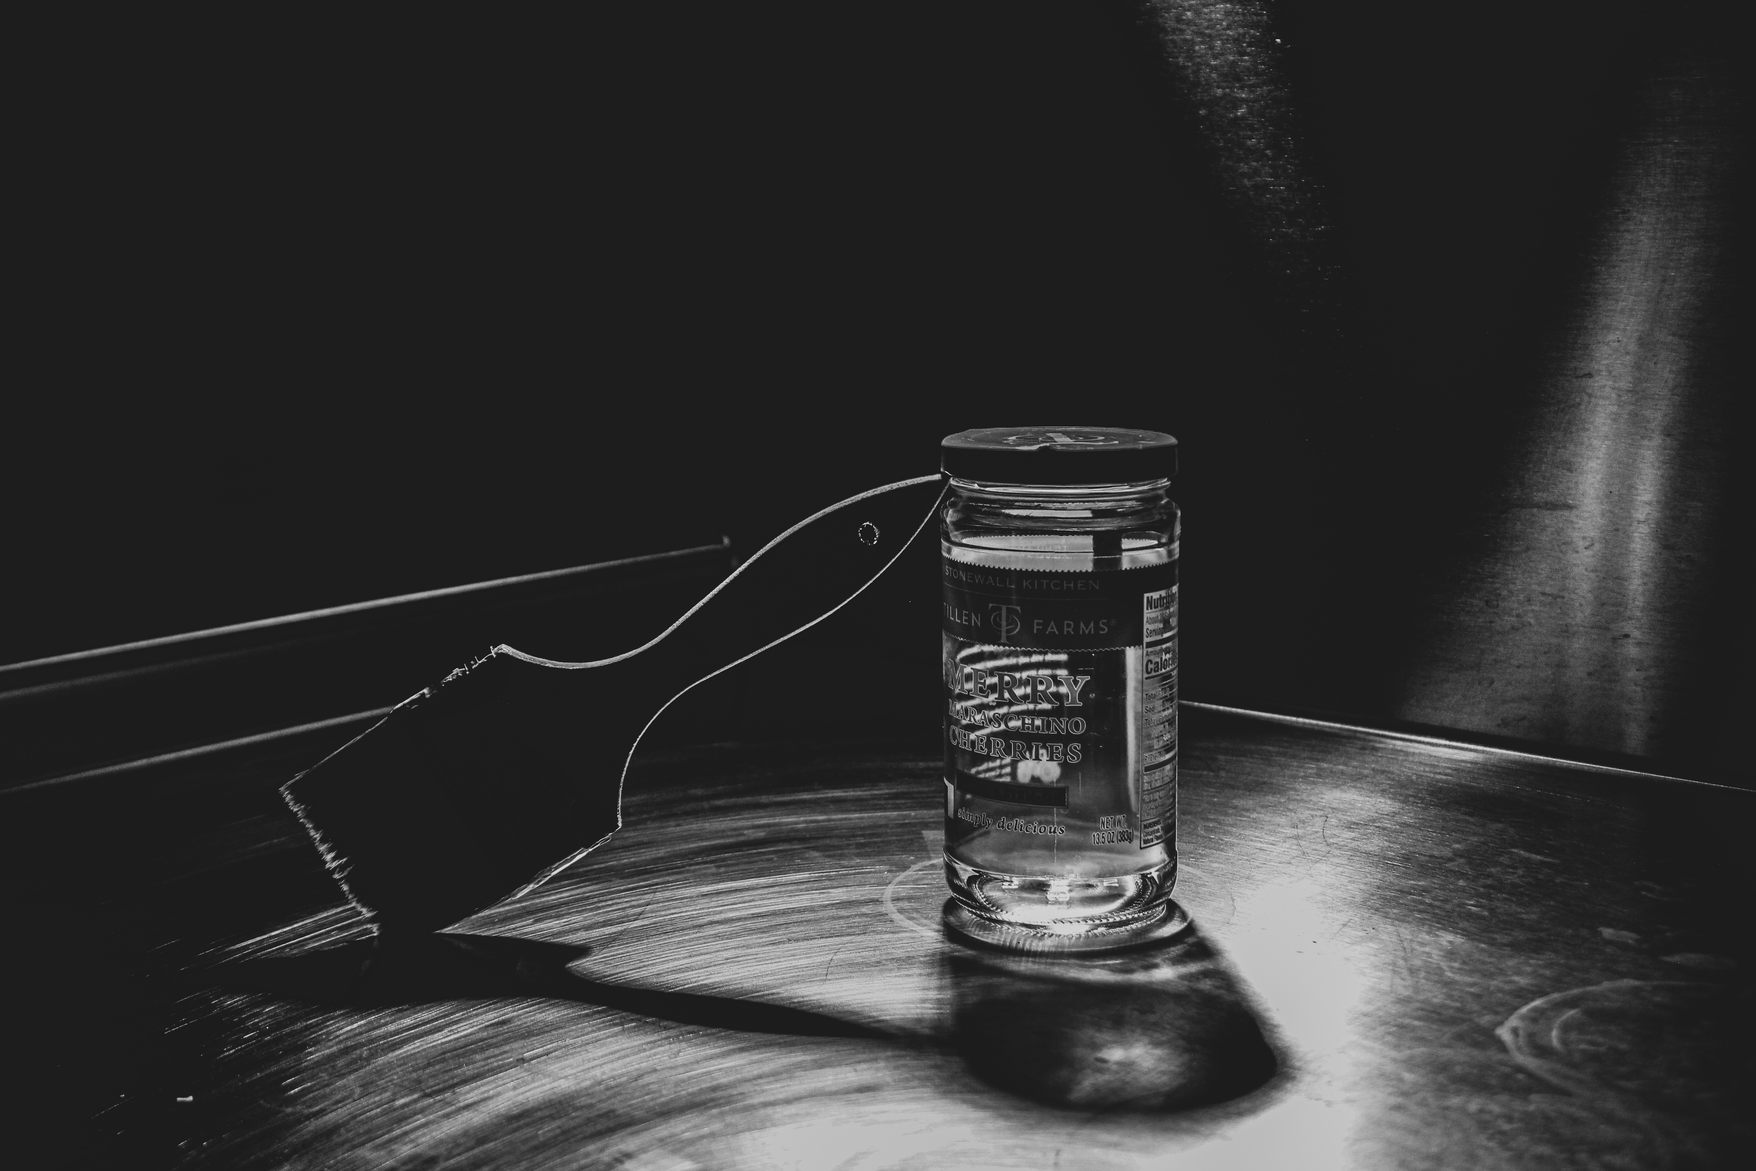
Allison Webster
Paint Brush and Jar Shadows
Digital Photograph/Digitally Manipulated Photograph

Slide 10
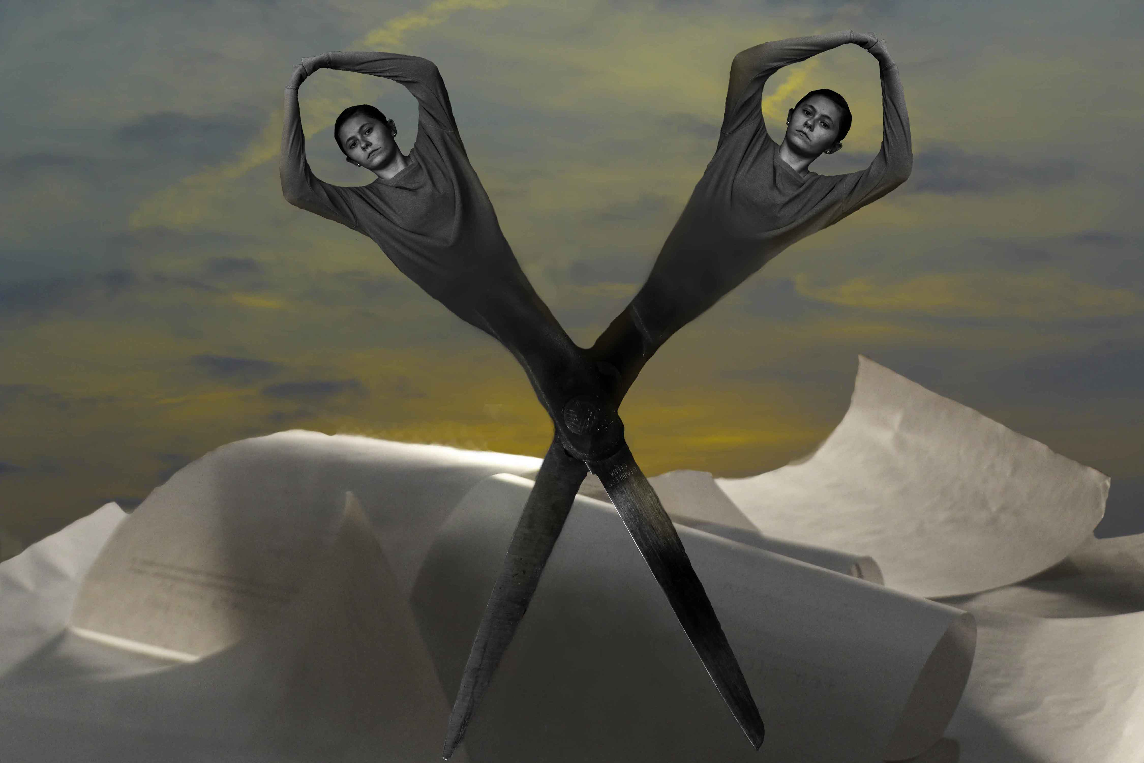
Allison Webster
Surrealist Painting Recreation
Digital Photograph/Digitally Manipulated Photograph

Slide 11
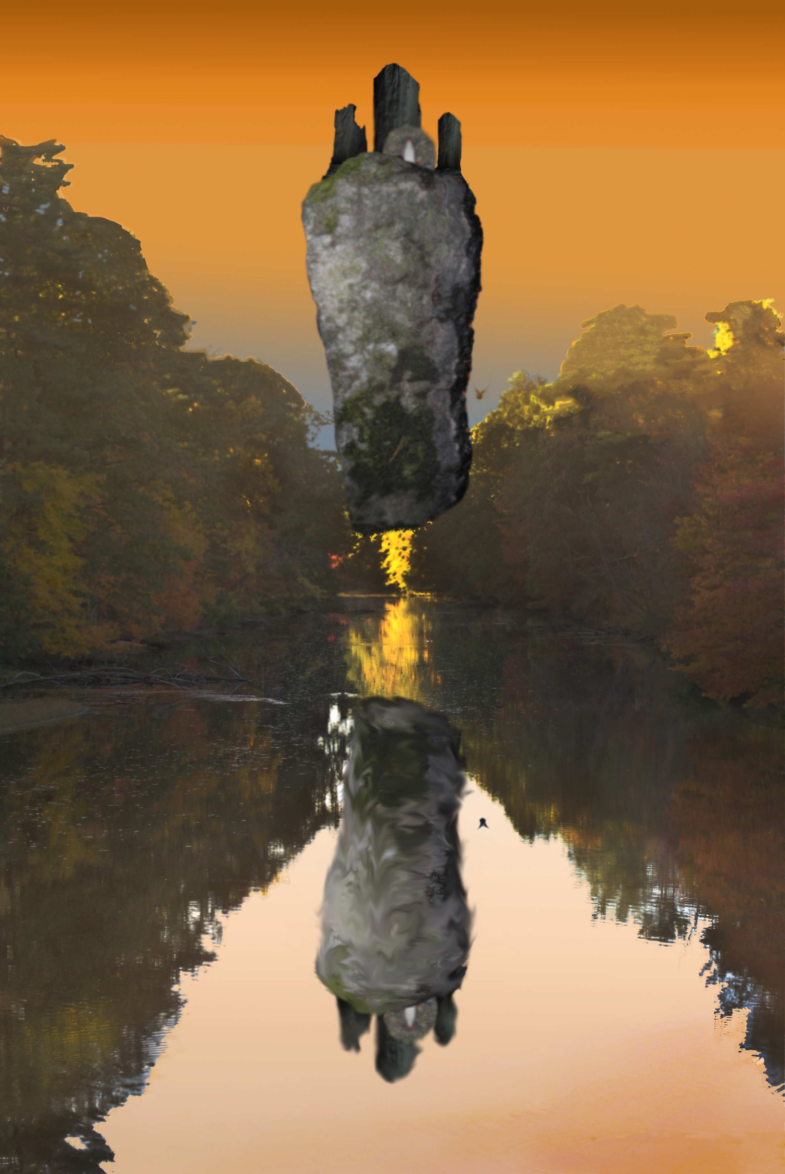
Jacob Paddock
Castle of Pyrenees
Digital Photograph

Slide 12
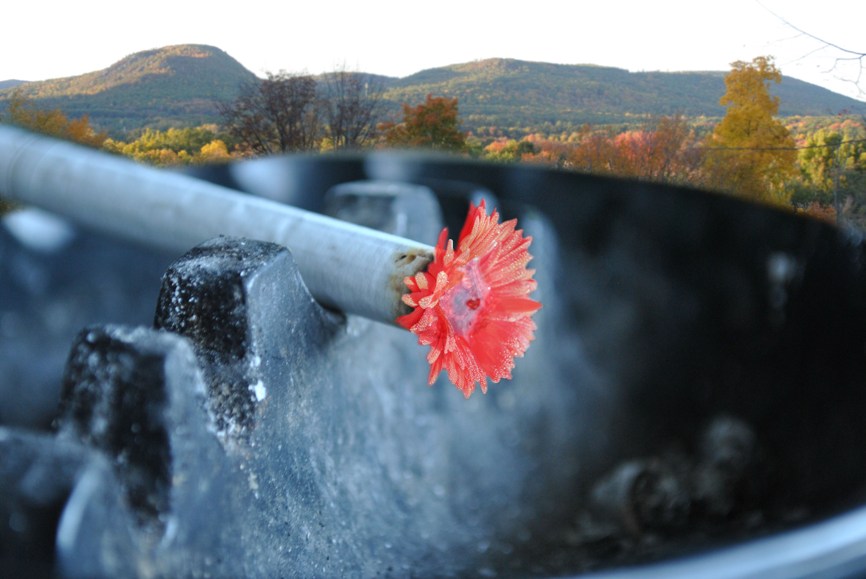
Jacob Paddock
Smoking Flower
Digital Photograph

Slide 13
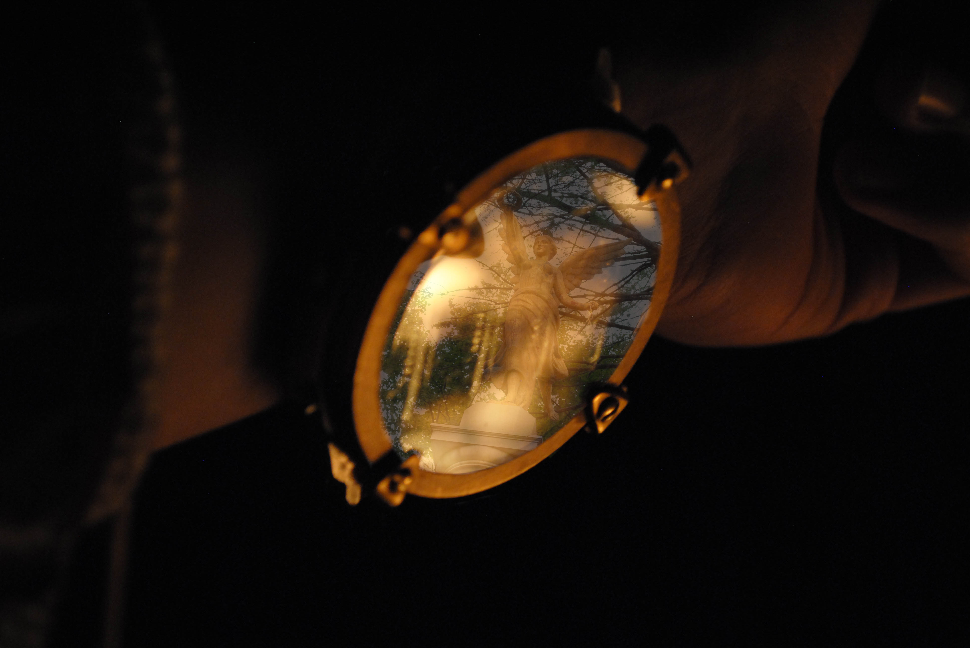
Jacob Paddock
Watcher
Digital Photograph

Slide 14
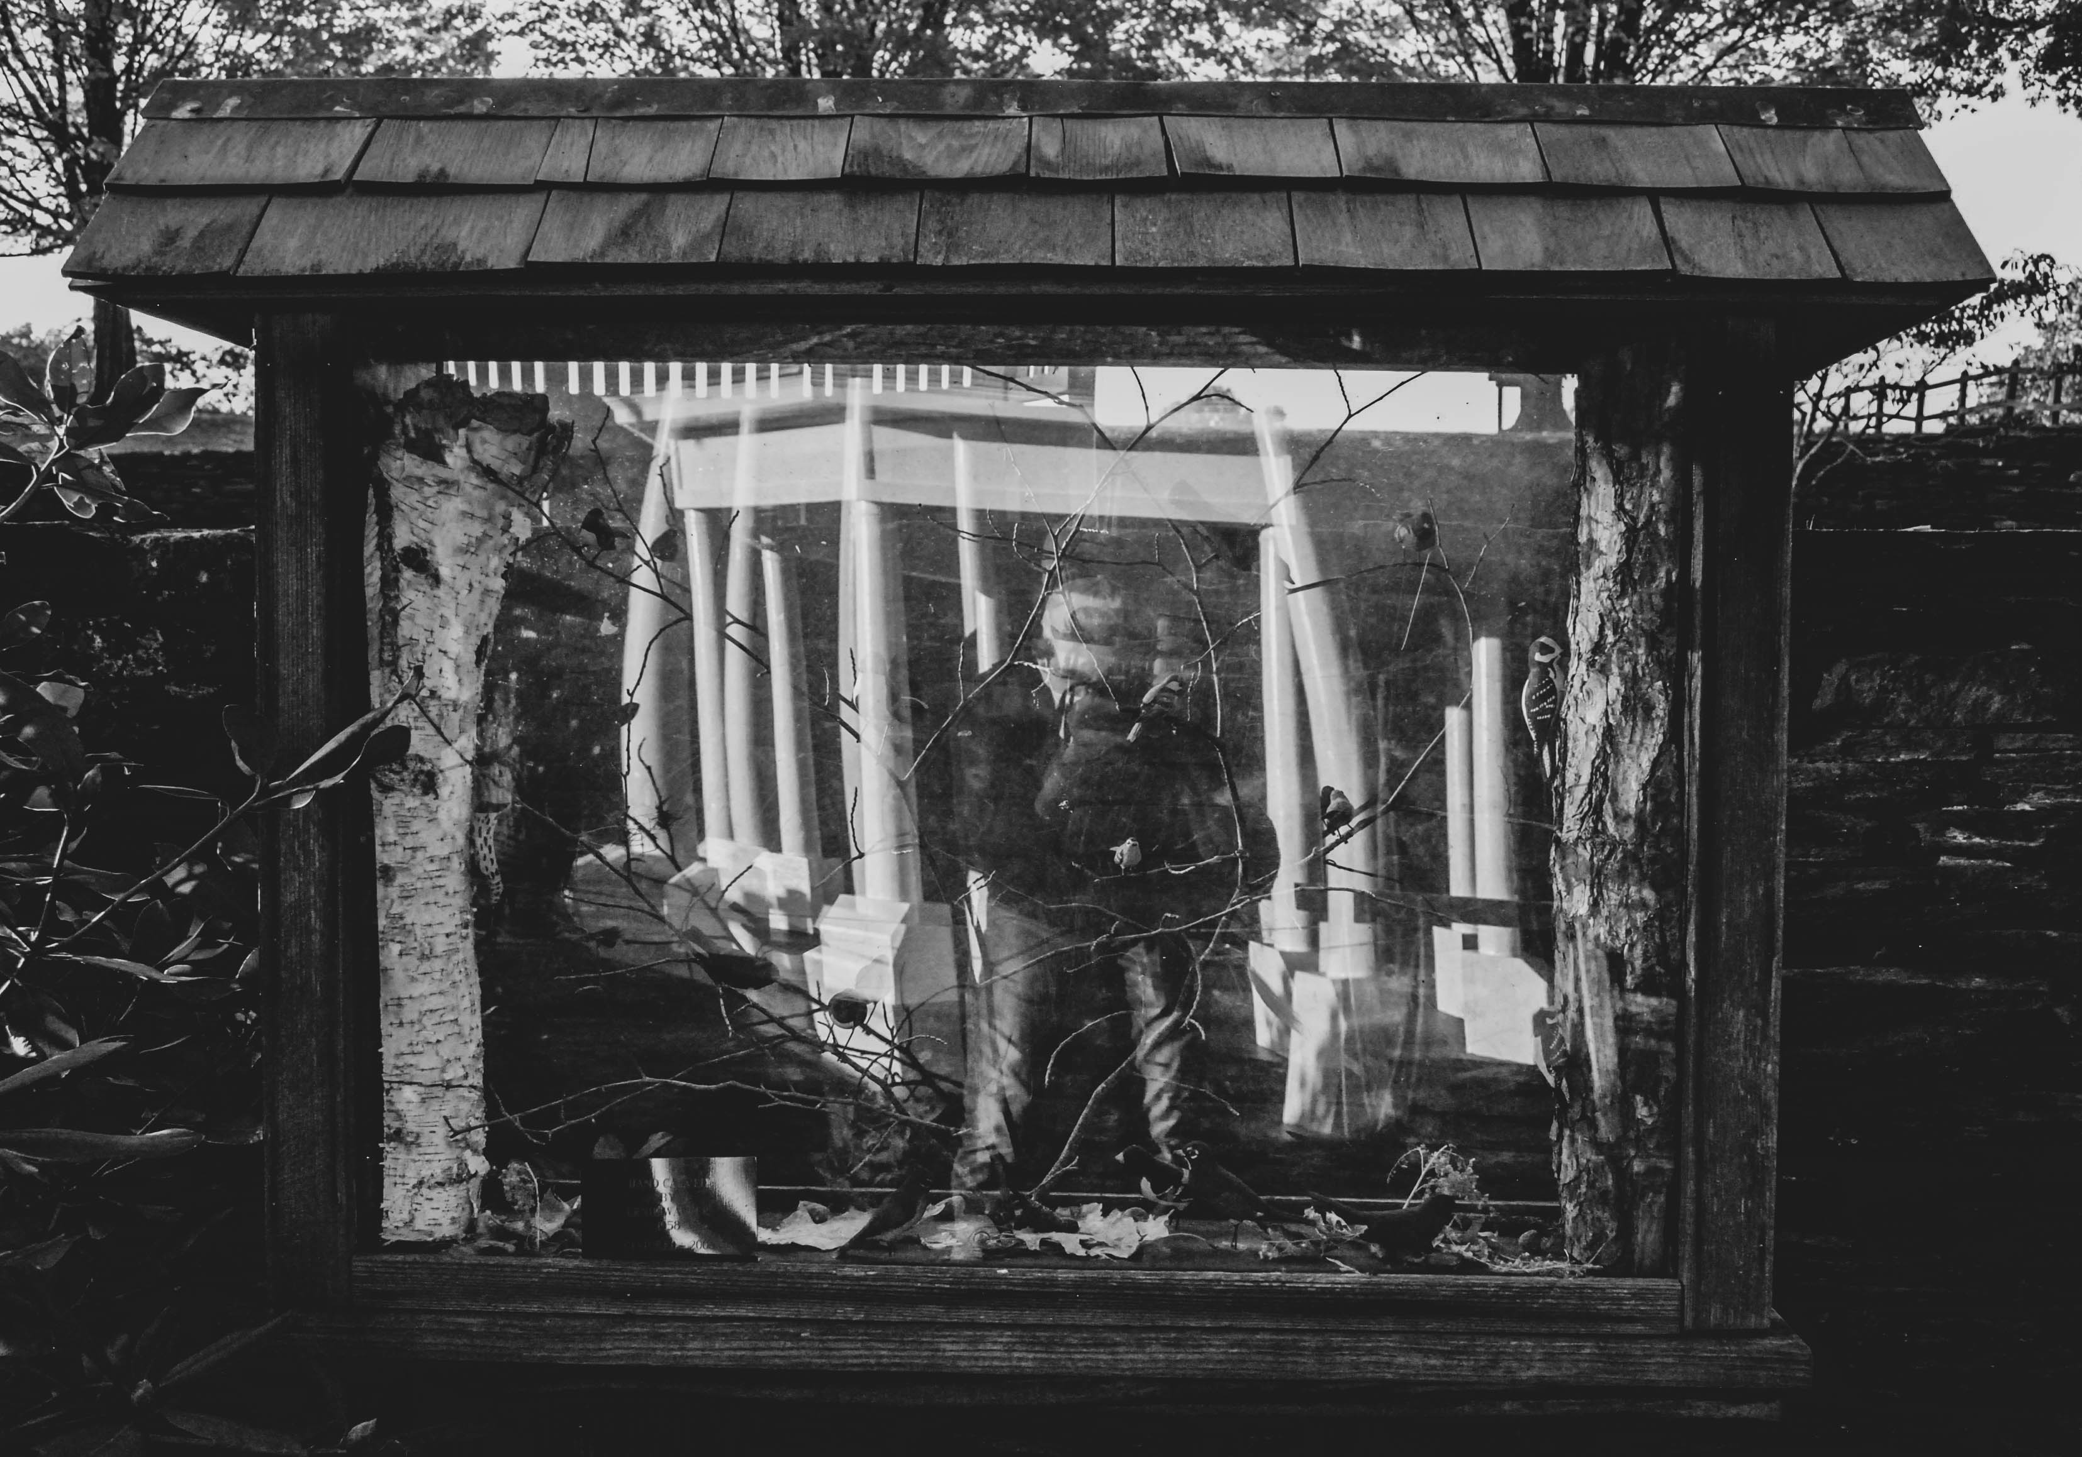
Jacob Paddock
Woodland Venu. 2020
Digital Photograph

Slide 15
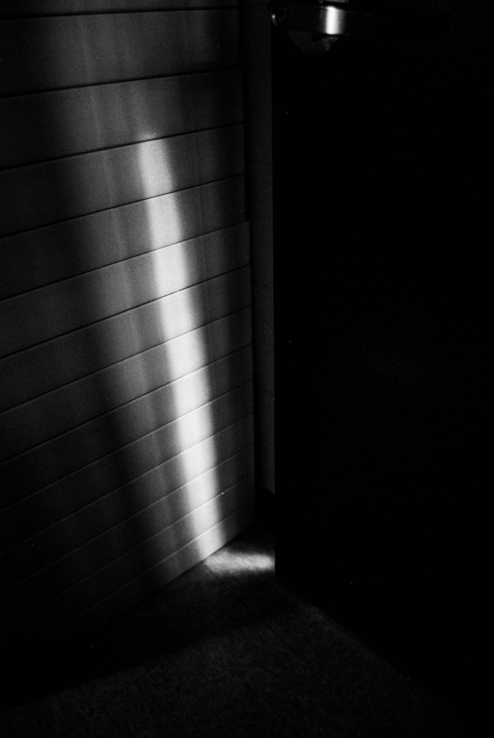
Jacob Paddock
Shadow
Digital Photograph

Slide 16
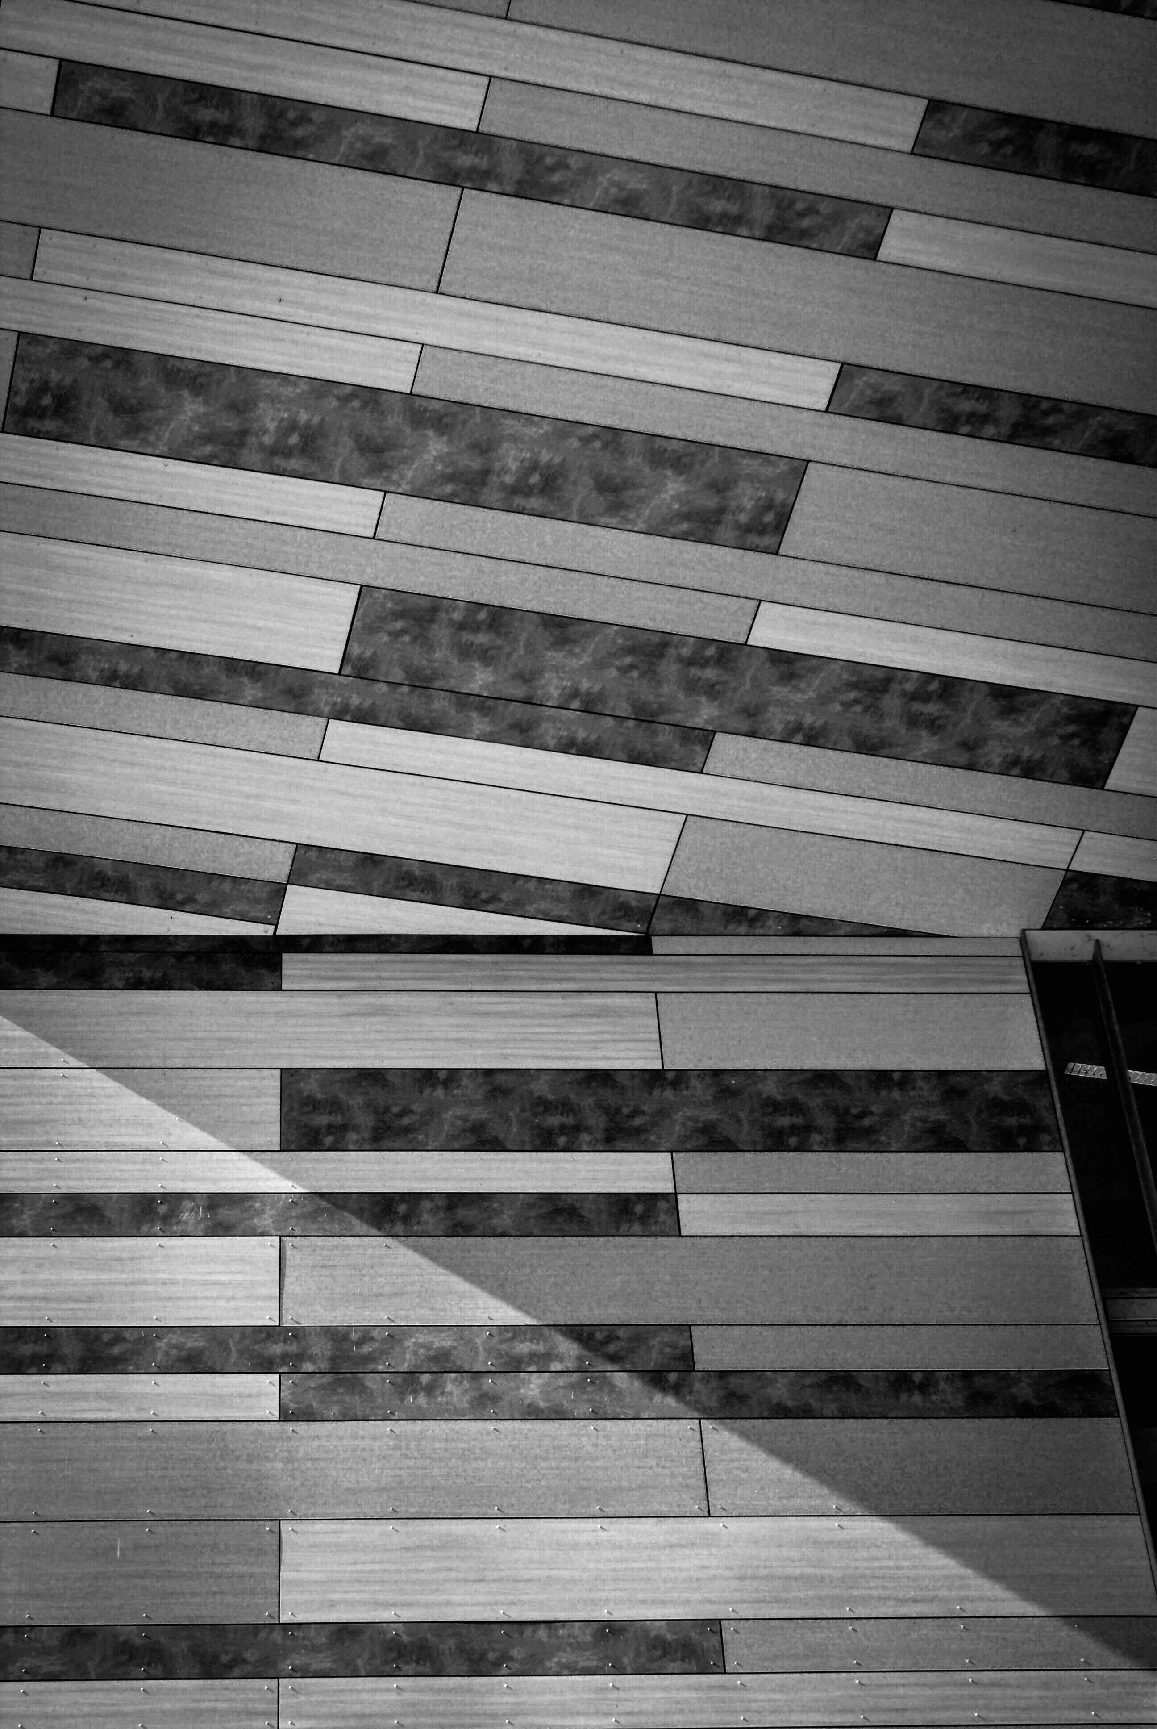
Michael Kasubali
Lines
Digital Photograph

Slide 17
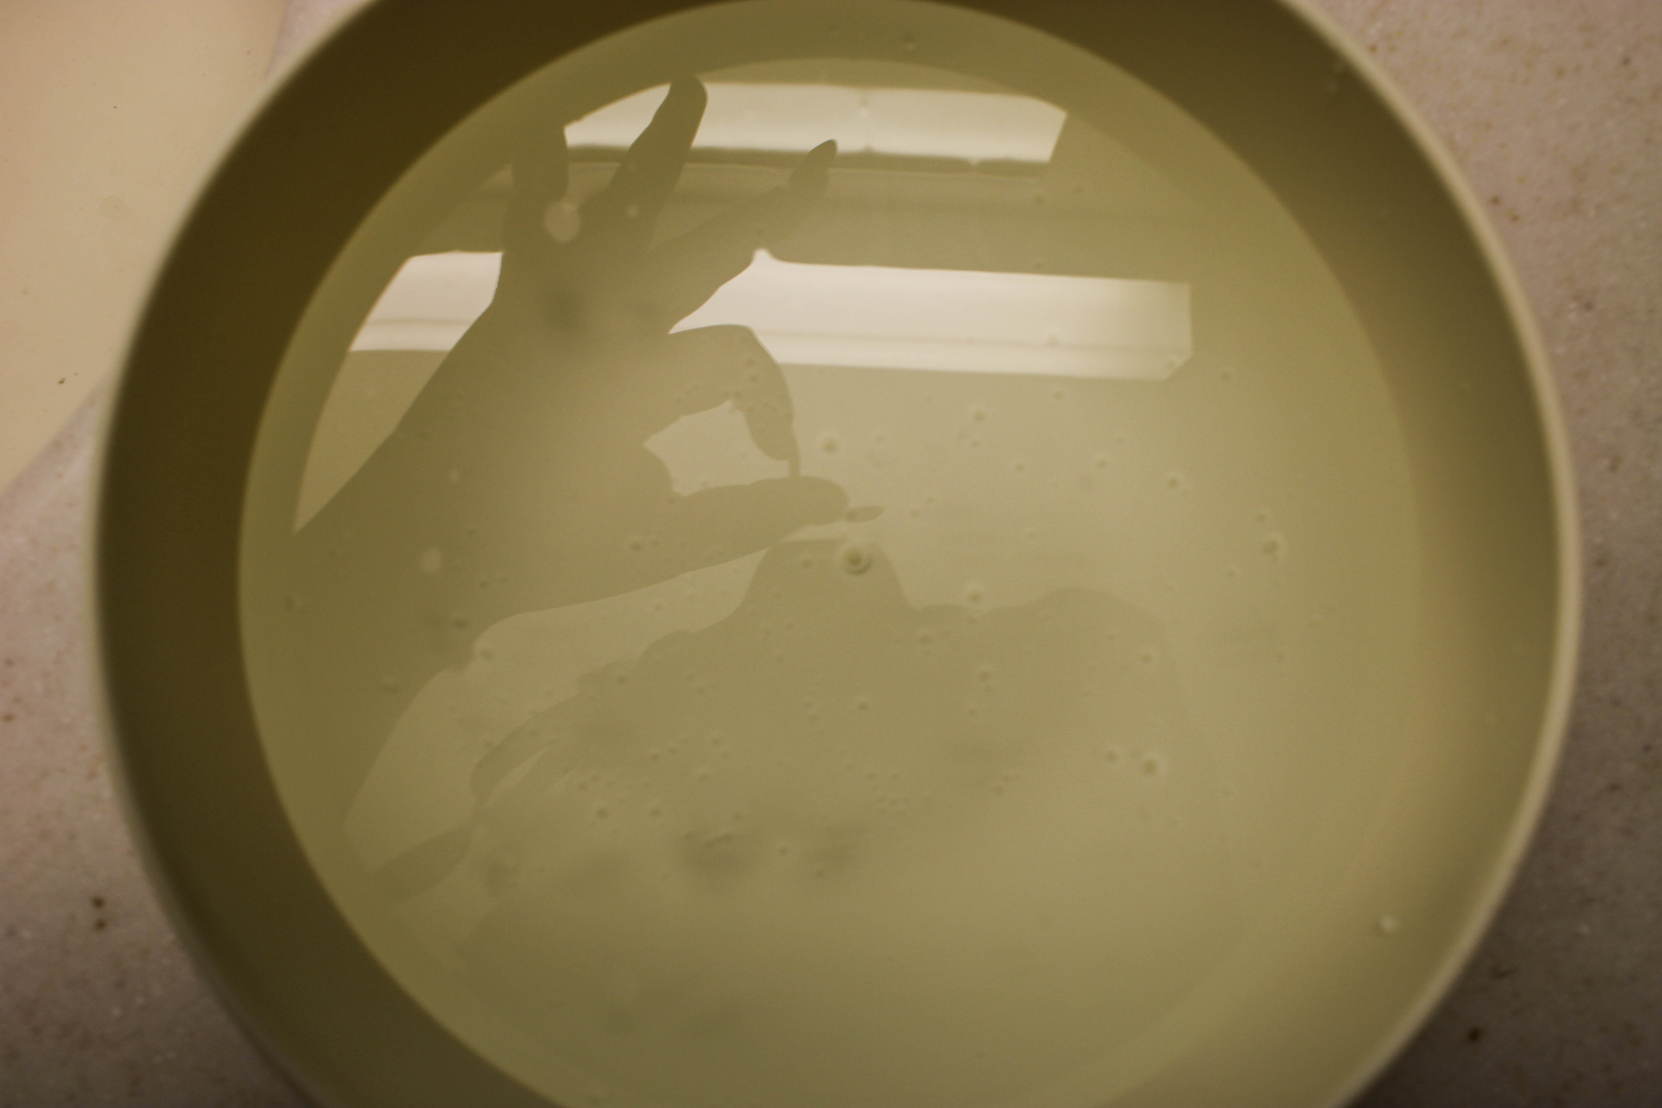
Odette Benes
Reflection
Digital Photograph

Slide 18
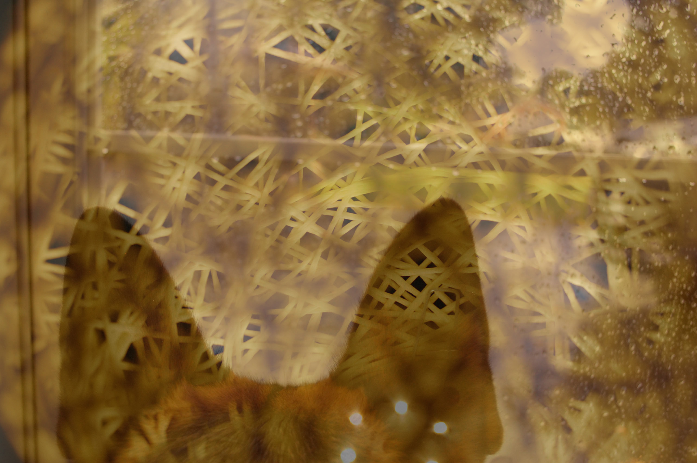
Shames Jalil
1
Digital Photograph

Slide 19
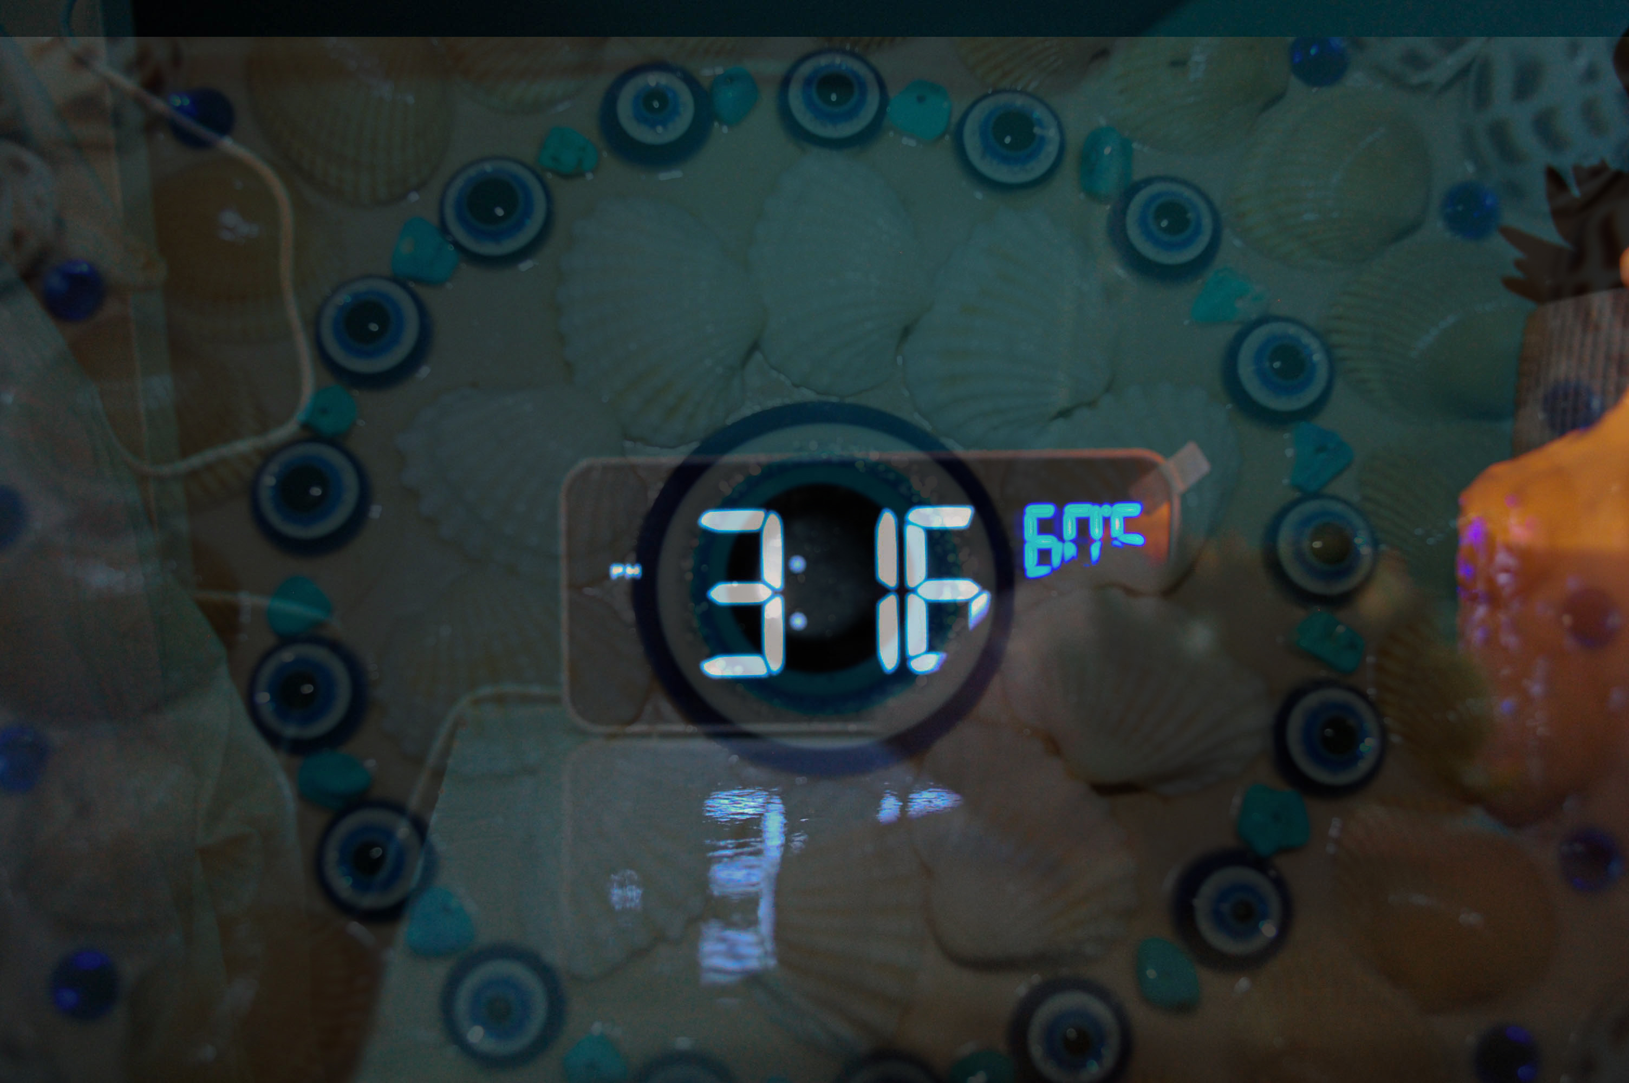
Shames Jalil
2
Digital Photograph

Slide 20
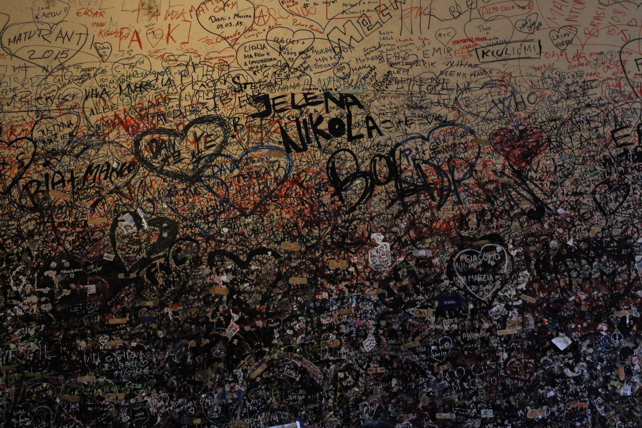
Tess Whitaker
Lines
Digital Photograph

Slide 21
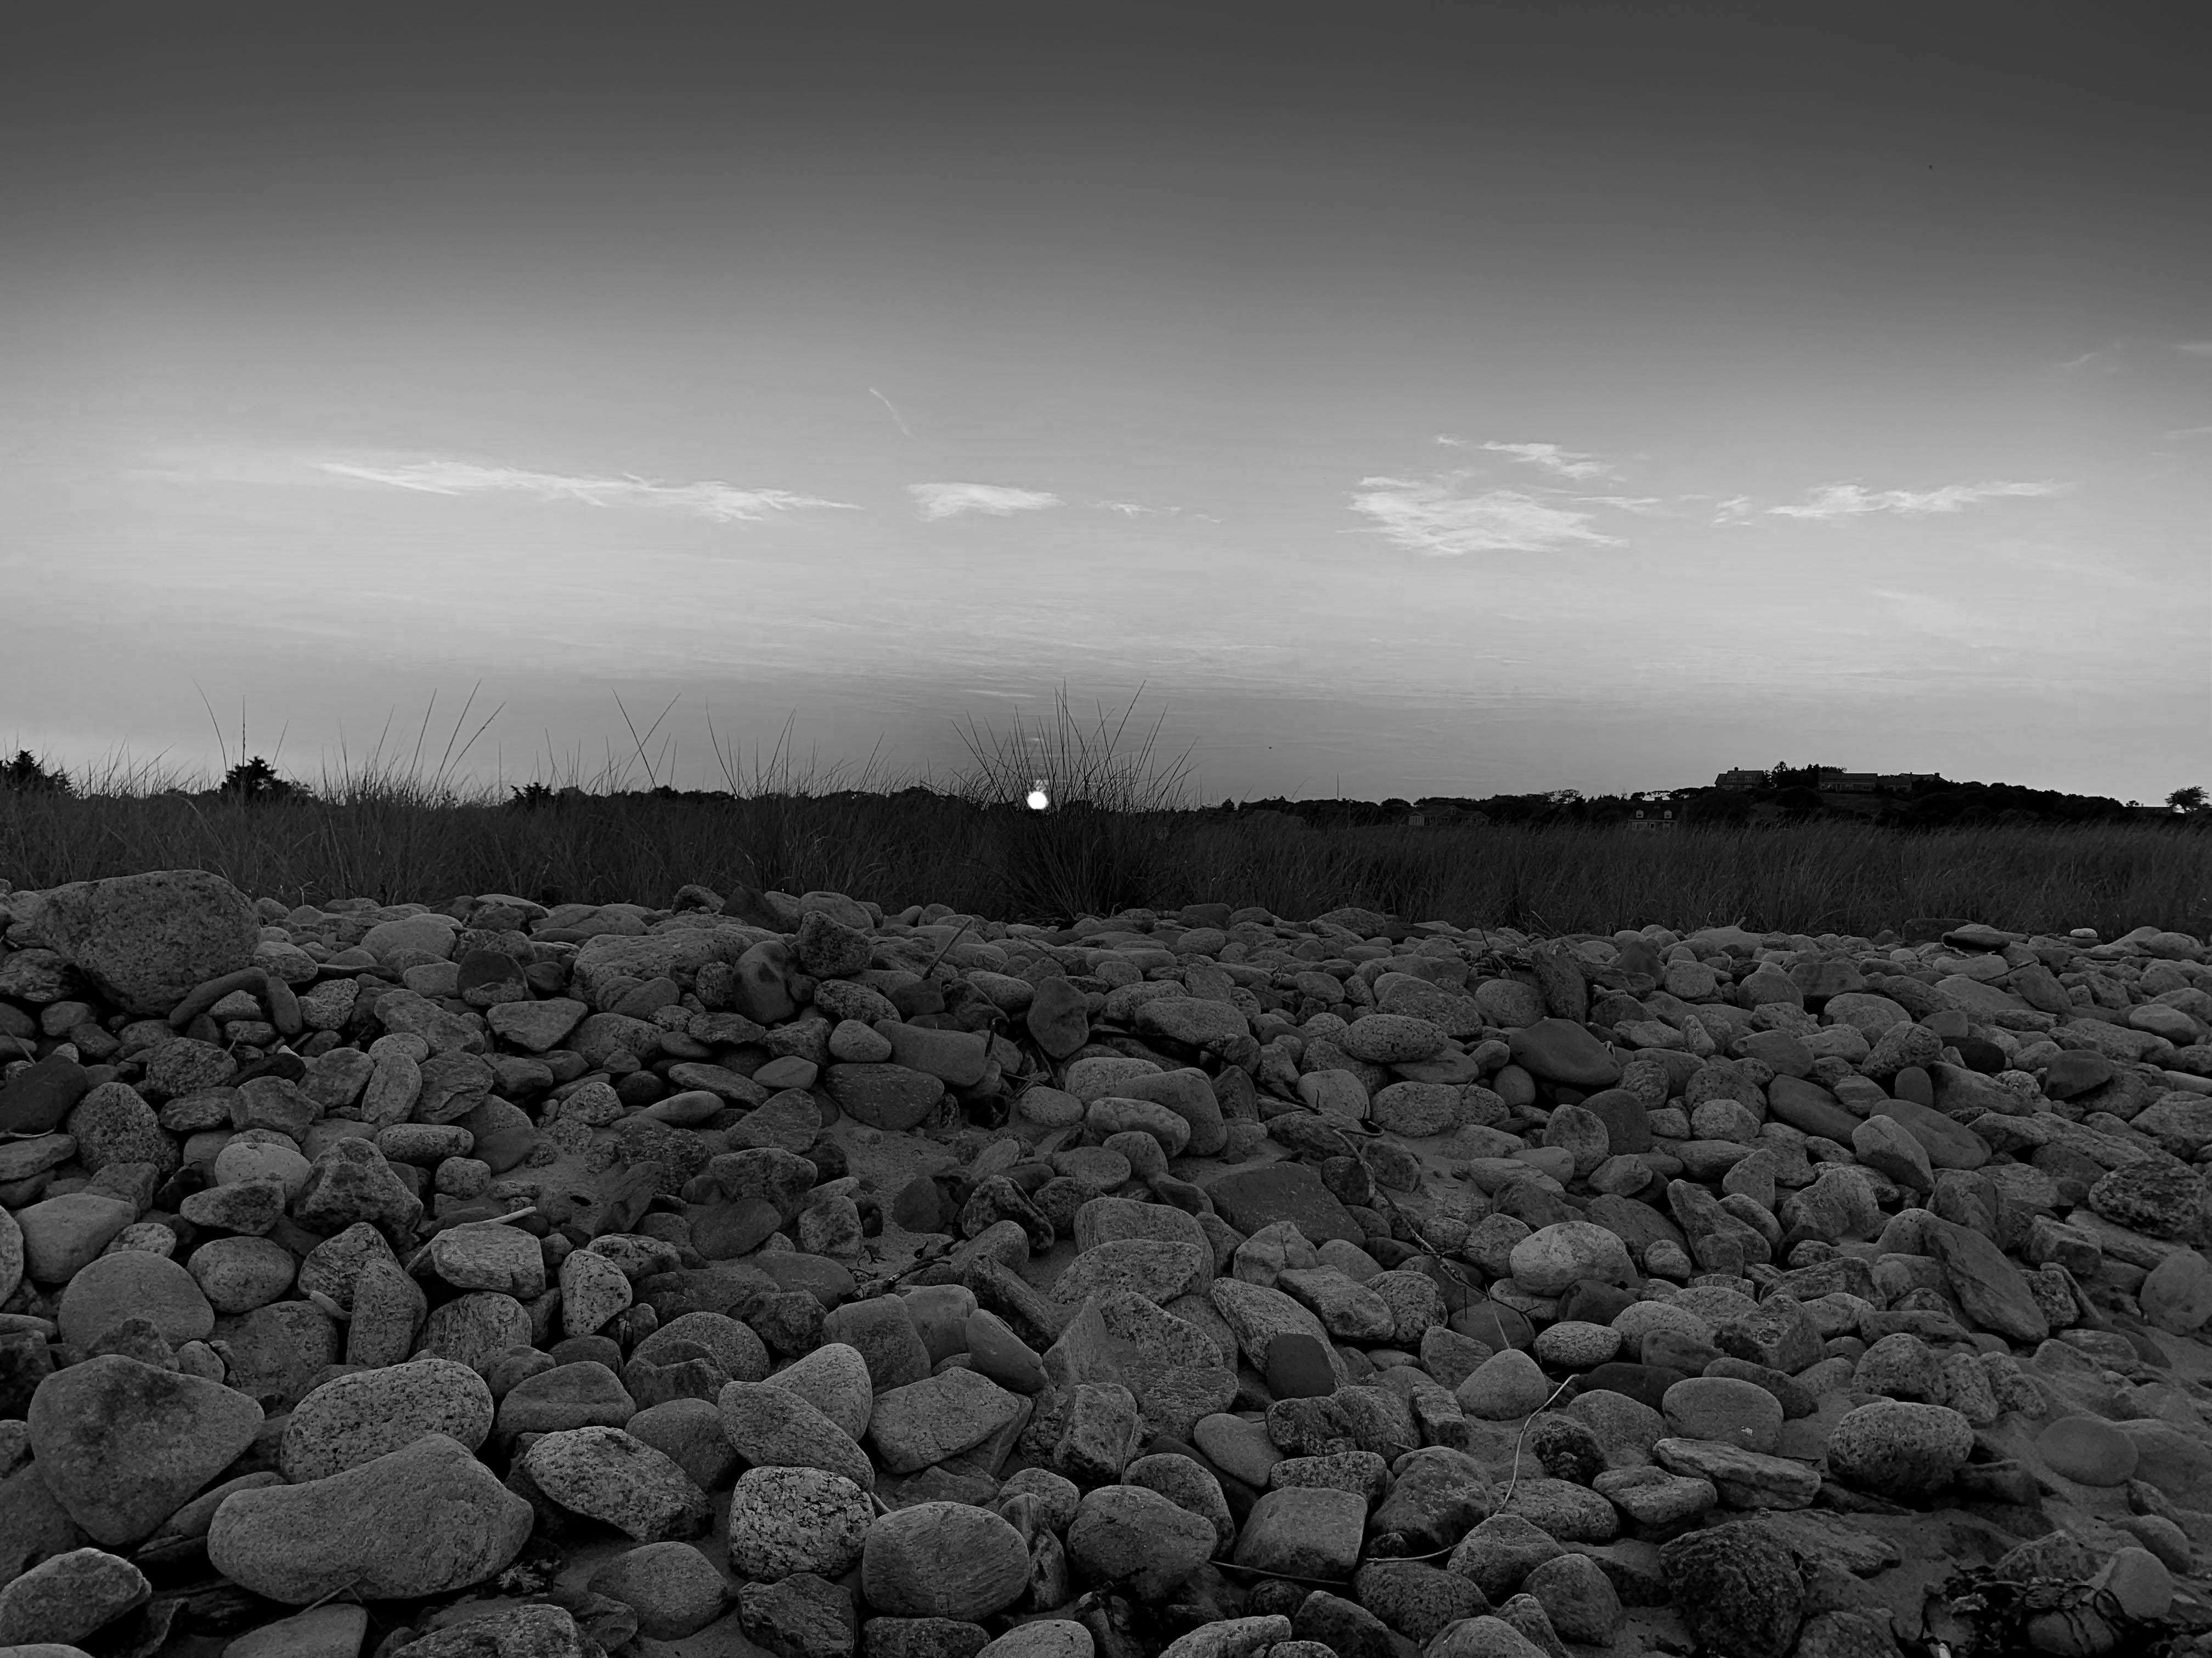
Tess Whitaker
Lines
Digital Photograph

Slide 22
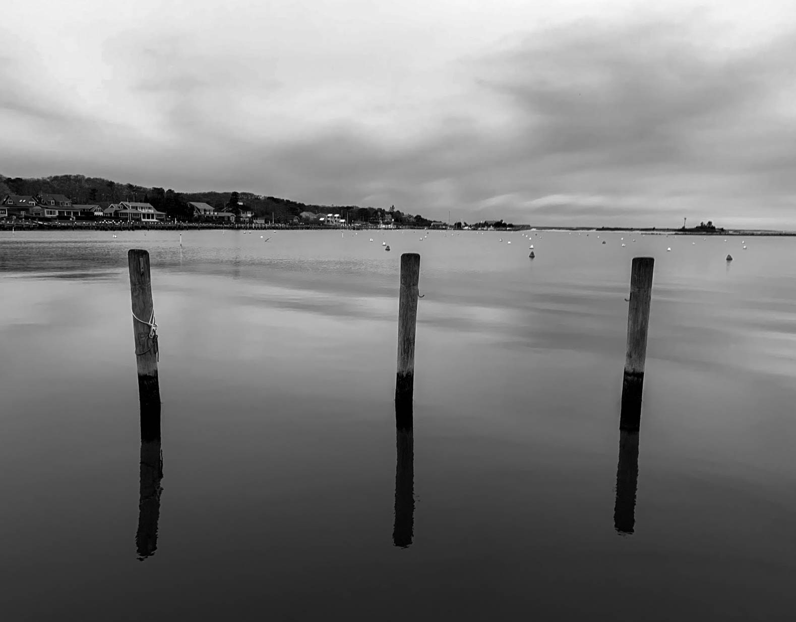
Tess Whitaker
Reflections
Digital Photograph

Slide 23
I hope you have enjoyed a taste of the creative spirit as portrayed by WSU Photography Class students. Be mindful that this school year we have a full repertoire of virtual art exhibitions available on the Arno Maris Gallery website:
www.westfield.ma.edu/arno
Faith Lund
Arno Maris Gallery Director/Curator
Westfield State University

